Slide 1
1010043316
Analysis and Design of Algorithms
Unit 3: DYNAMIC PROGRAMMING
SEMESTER: 5

Slide 2
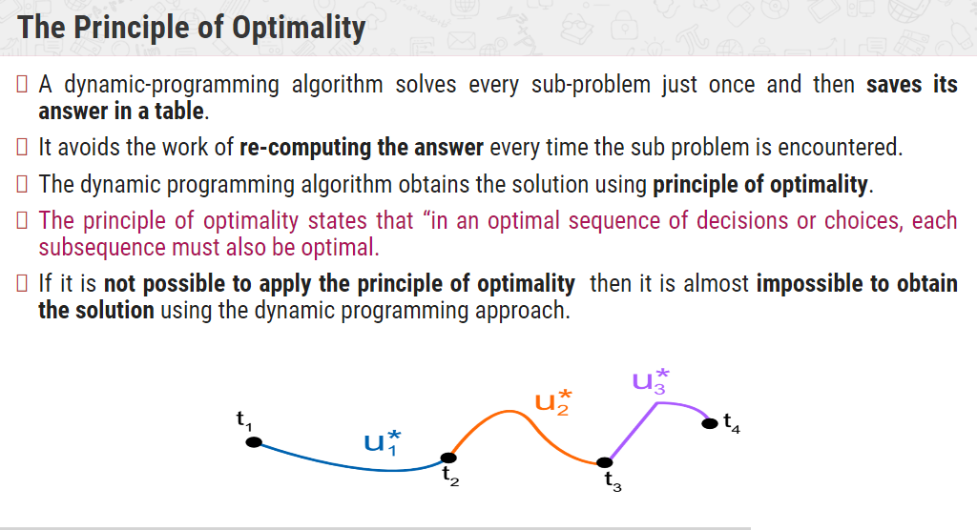

Slide 3
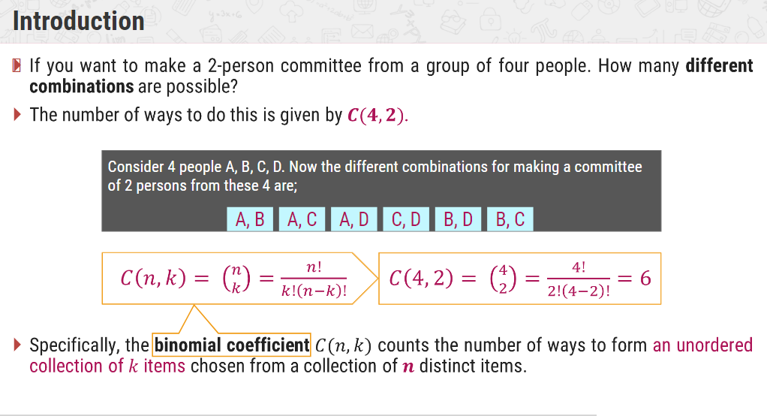
BINOMIAL COEFICIENT

Slide 4
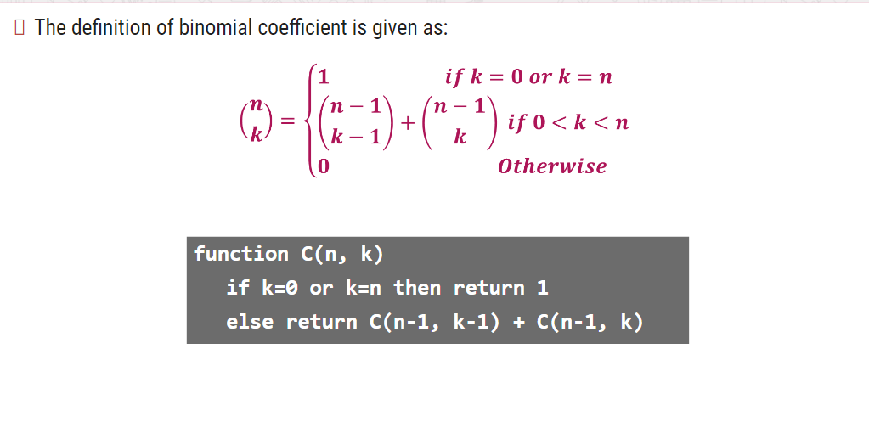
CONT’D.

Slide 5
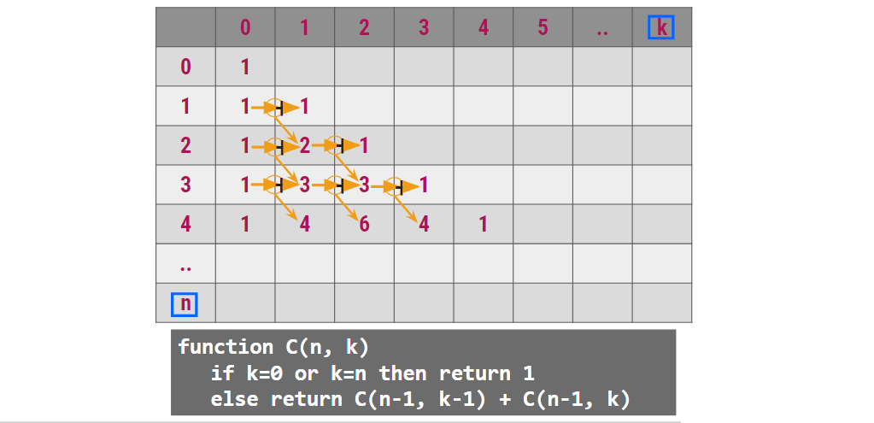
CONT’D.

Slide 6
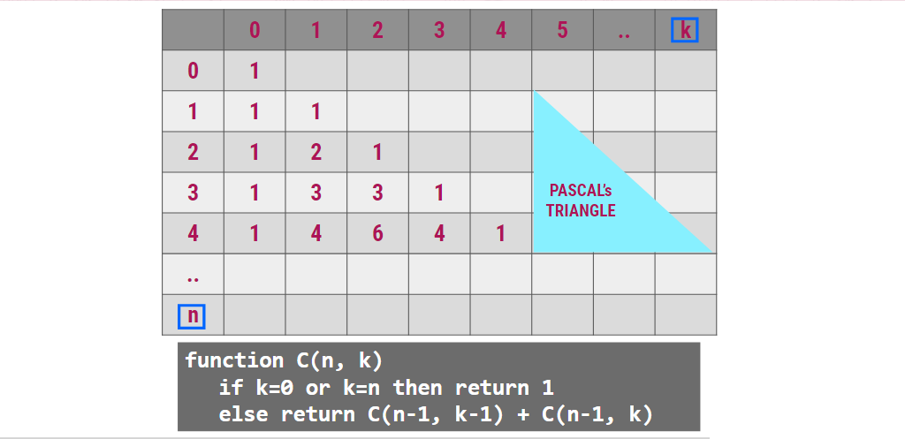
CONT’D.

Slide 7
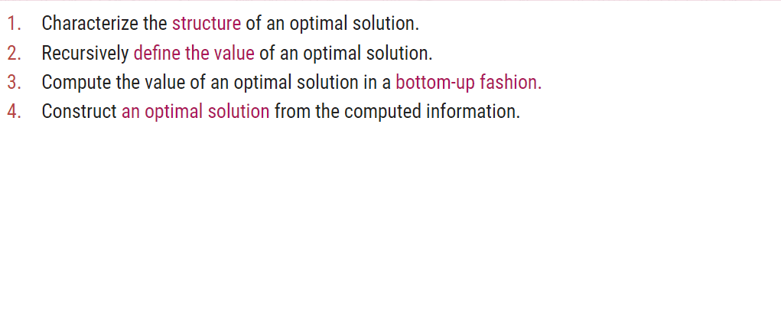
GENERALIZED SOLUTION USING DYNAMIC PROGRAMMING

Slide 8
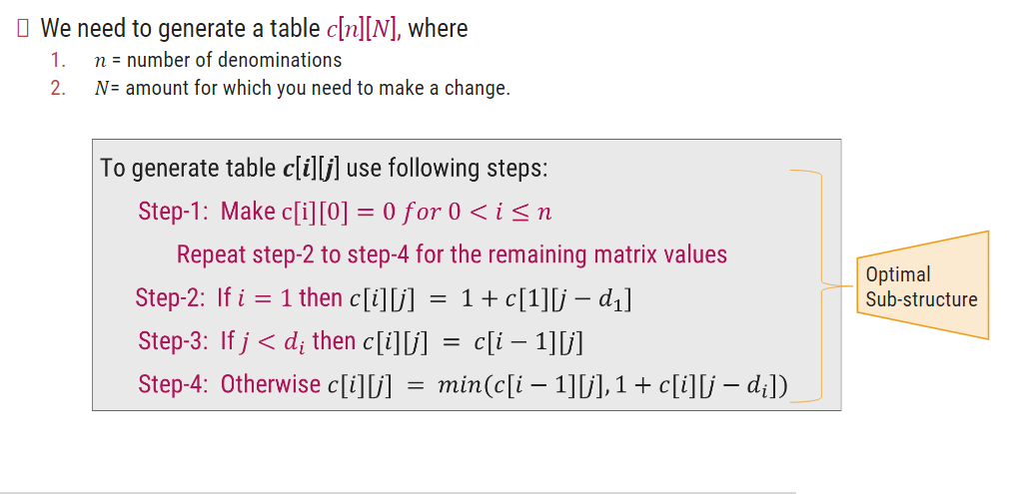
MAKING CHANGE PROBLEM

Slide 9
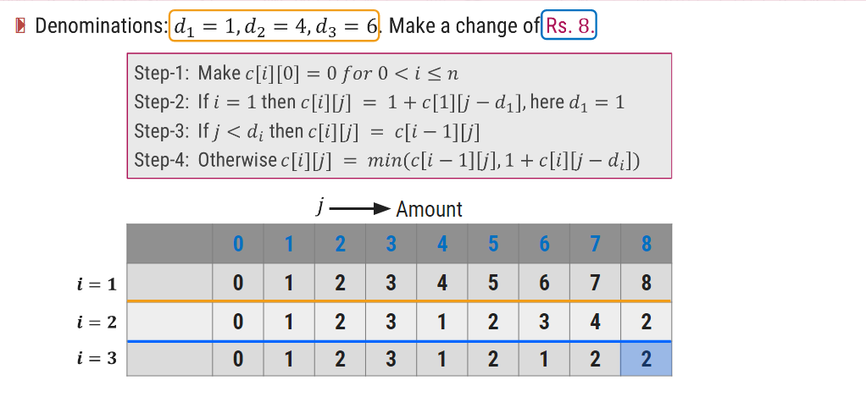
MAKING CHANGE PROBLEM

Slide 10
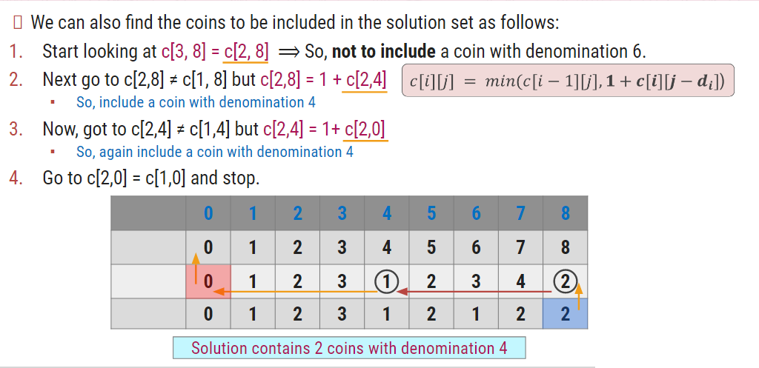
MAKING CHANGE PROBLEM

Slide 11
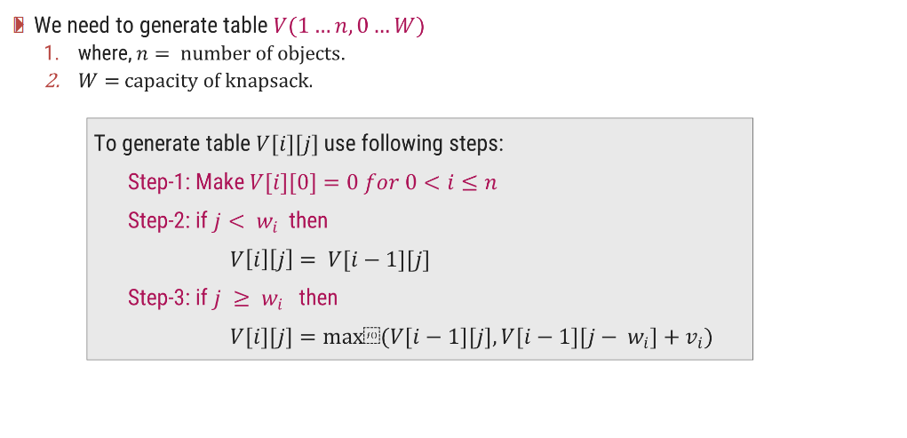
0/1 KNAPSACK PROBLEM

Slide 12
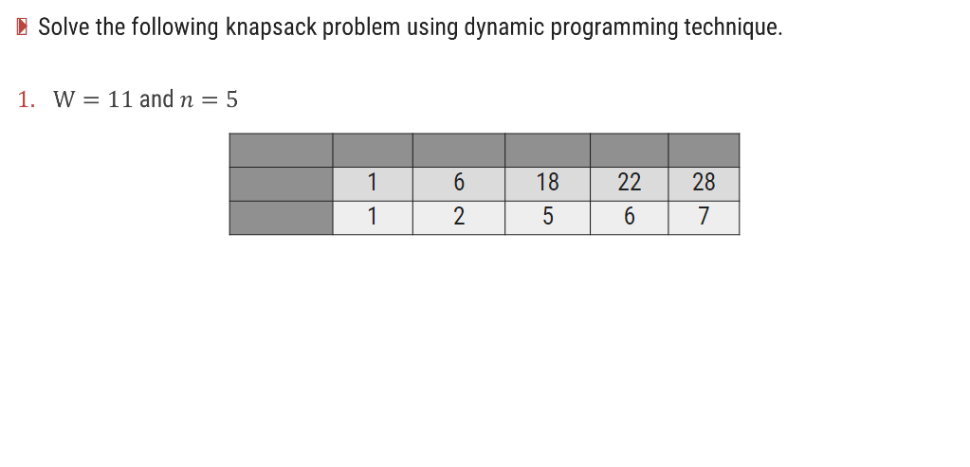
0/1 KNAPSACK PROBLEM

Slide 13
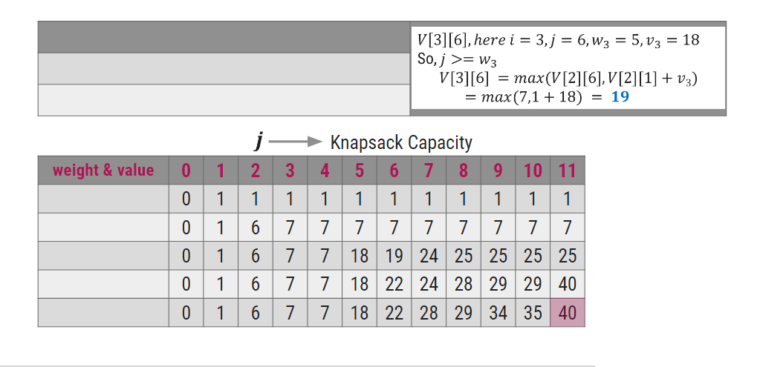
0/1 KNAPSACK PROBLEM

Slide 14
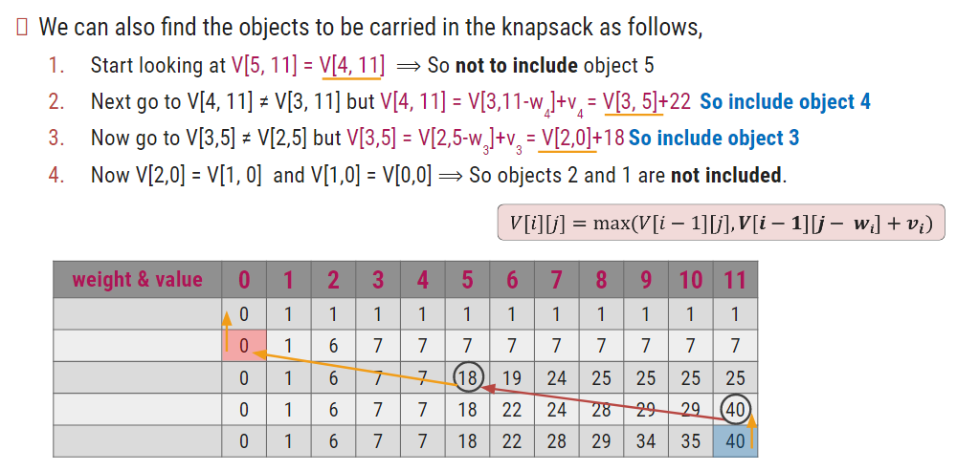
0/1 KNAPSACK PROBLEM

Slide 15
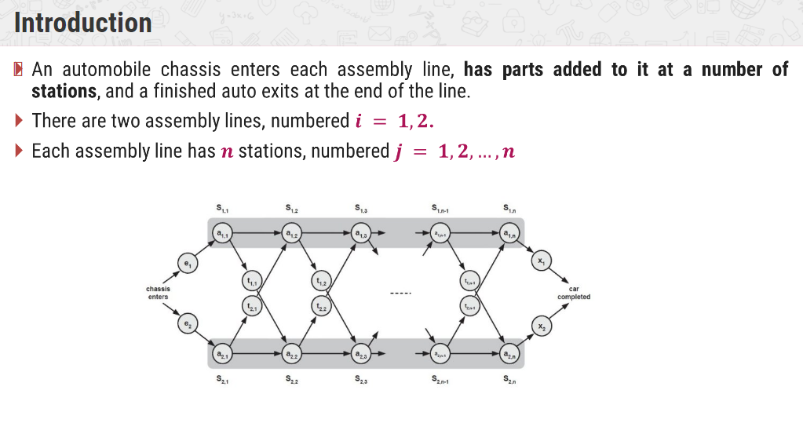
ASSEMBLY LINE SCHEDULING

Slide 16
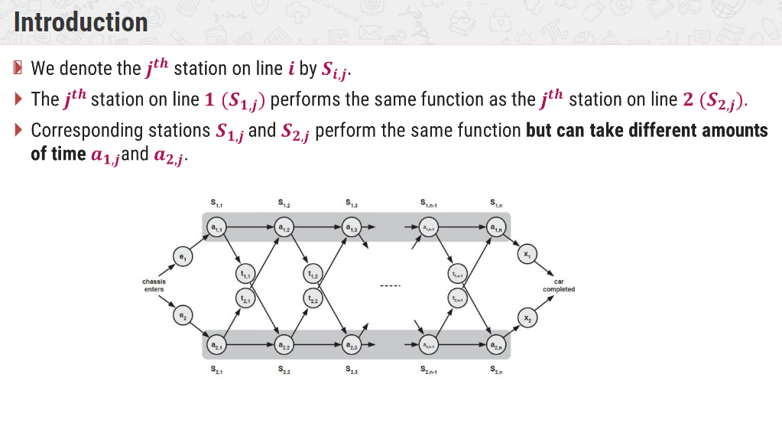
ASSEMBLY LINE SCHEDULING

Slide 17
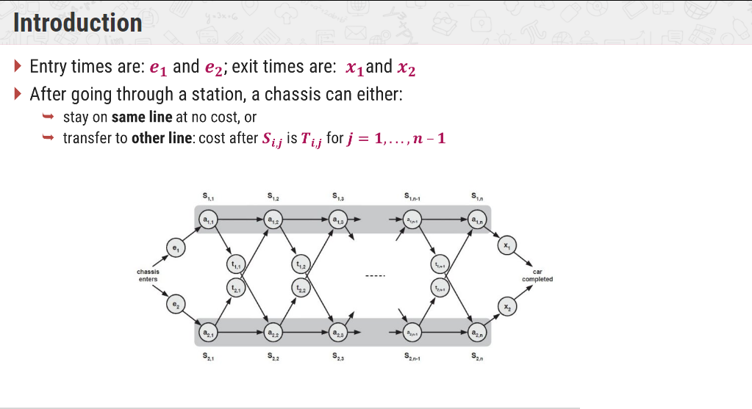
ASSEMBLY LINE SCHEDULING

Slide 18
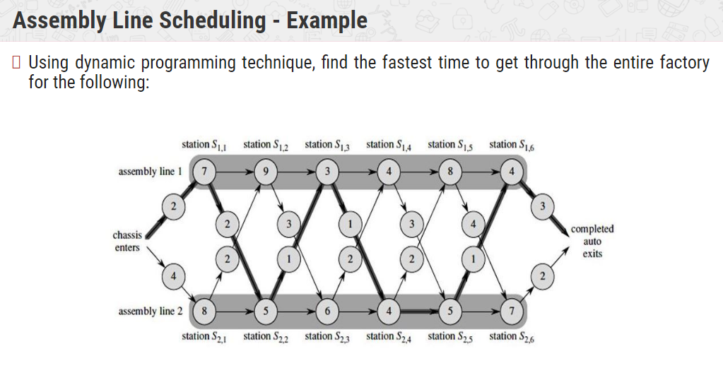
ASSEMBLY LINE SCHEDULING

Slide 19
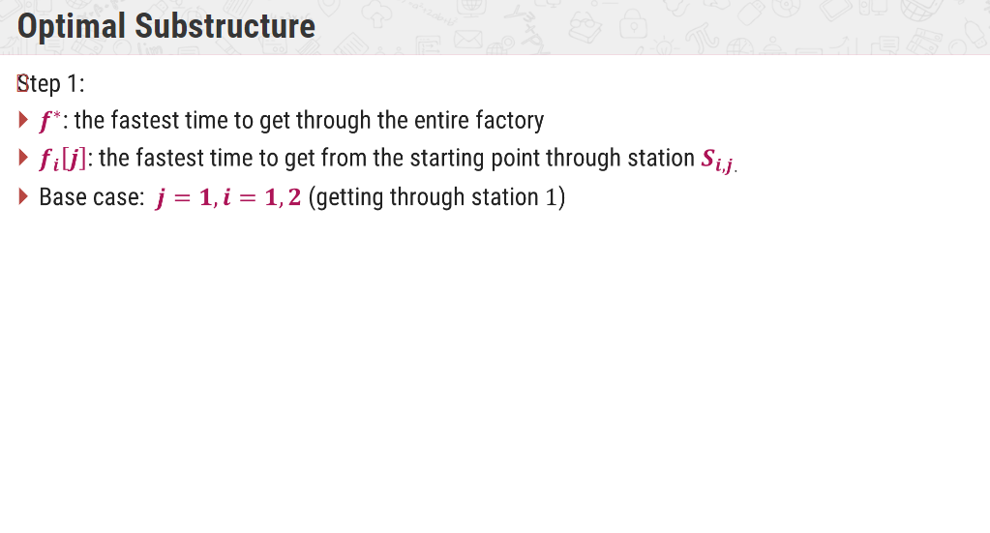
ASSEMBLY LINE SCHEDULING

Slide 20
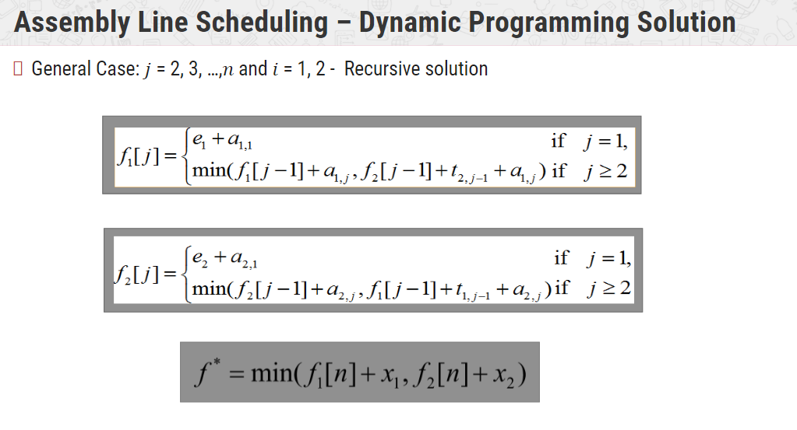
ASSEMBLY LINE SCHEDULING

Slide 21
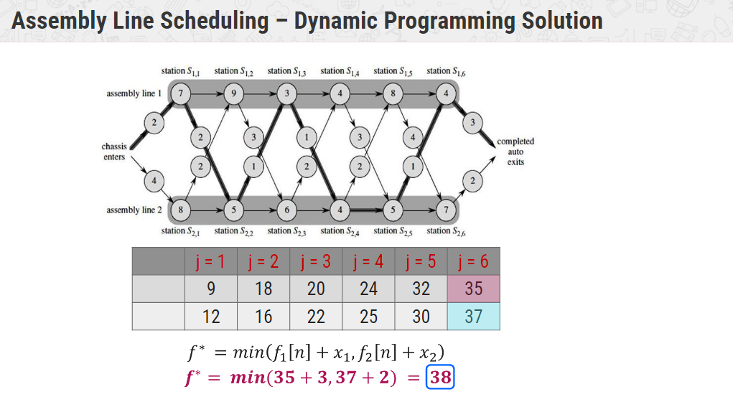
ASSEMBLY LINE SCHEDULING

Slide 22
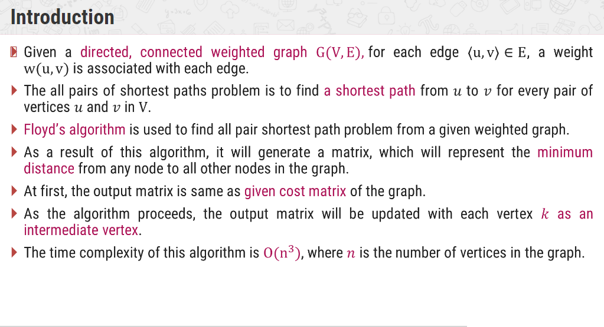
ALL PAIR SHORTEST PATH – FLOYD’S ALGORITHM

Slide 23
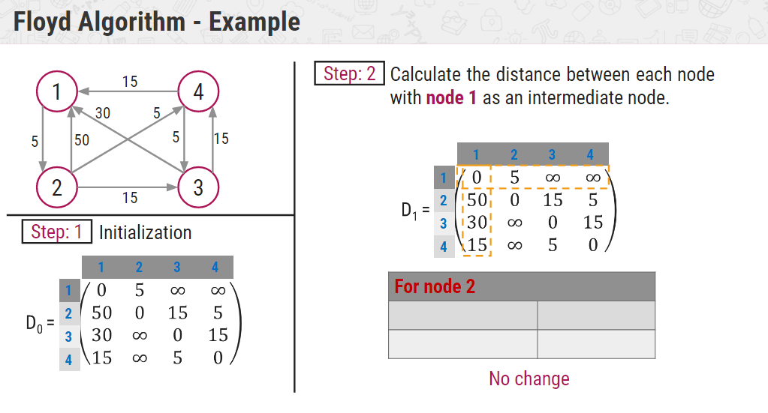
ALL PAIR SHORTEST PATH – FLOYD’S ALGORITHM

Slide 24
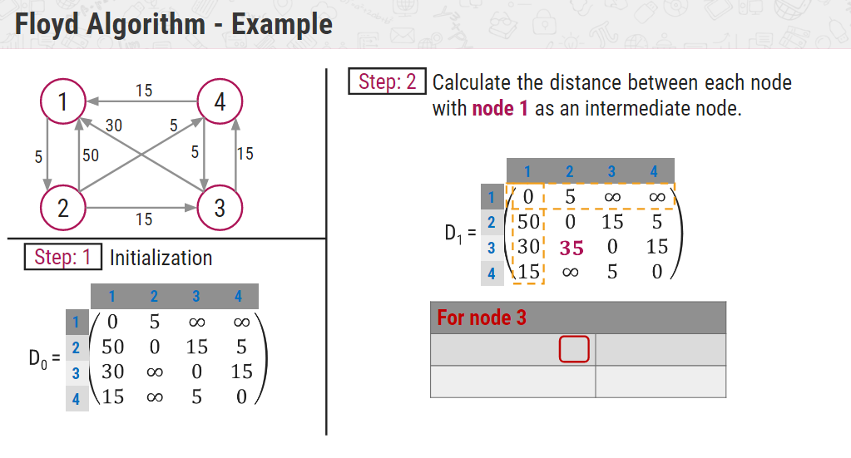
ALL PAIR SHORTEST PATH – FLOYD’S ALGORITHM

Slide 25
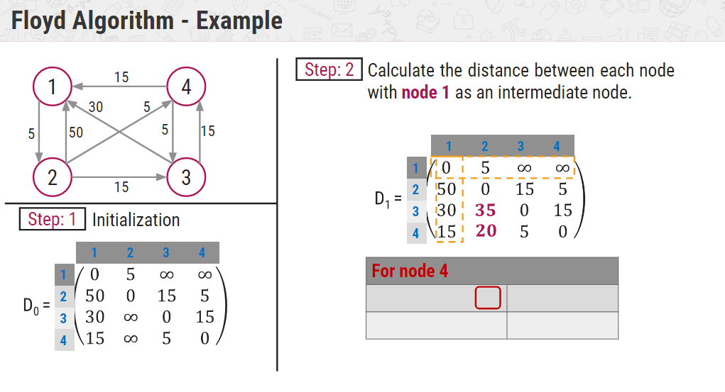
ALL PAIR SHORTEST PATH – FLOYD’S ALGORITHM

Slide 26
ALL PAIR SHORTEST PATH – FLOYD’S ALGORITHM

Slide 27
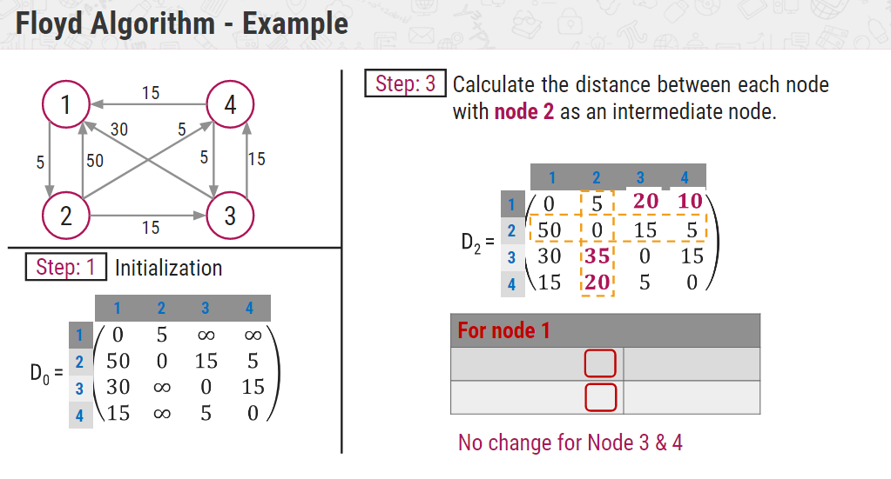
ALL PAIR SHORTEST PATH – FLOYD’S ALGORITHM

Slide 28
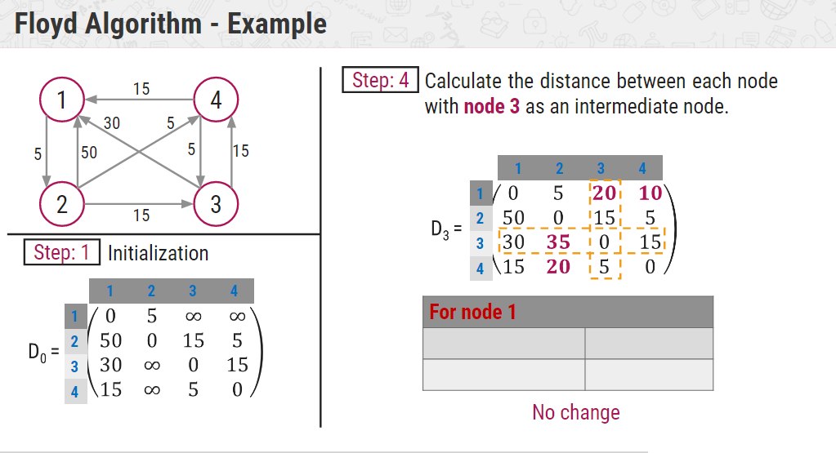
ALL PAIR SHORTEST PATH – FLOYD’S ALGORITHM

Slide 29
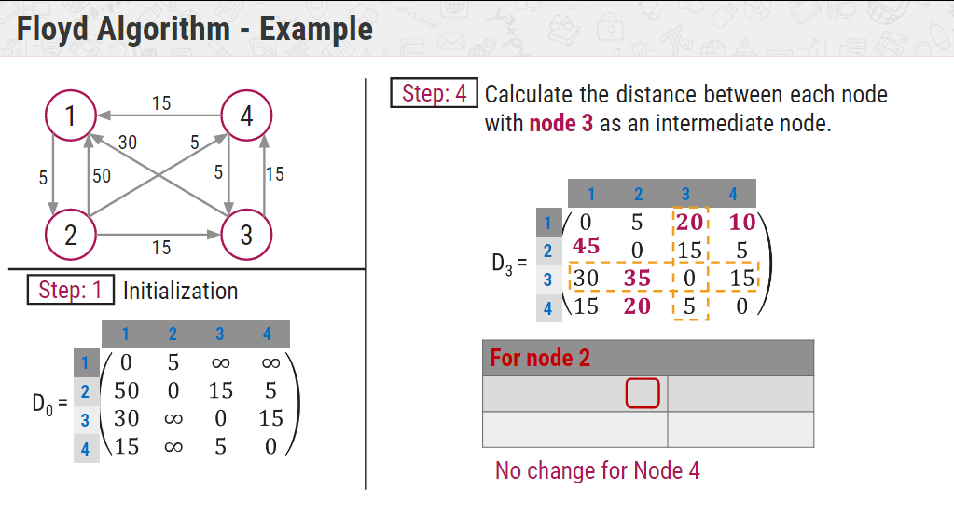
ALL PAIR SHORTEST PATH – FLOYD’S ALGORITHM

Slide 30
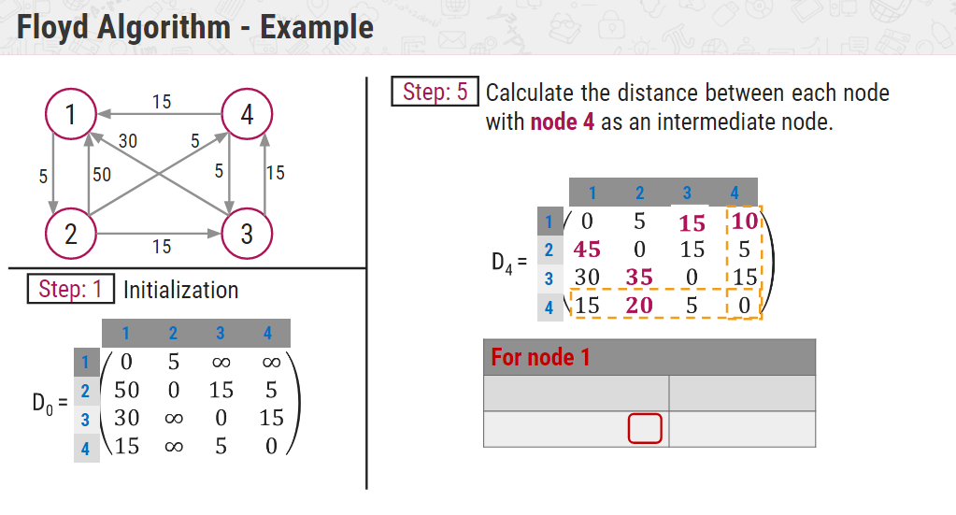
ALL PAIR SHORTEST PATH – FLOYD’S ALGORITHM

Slide 31
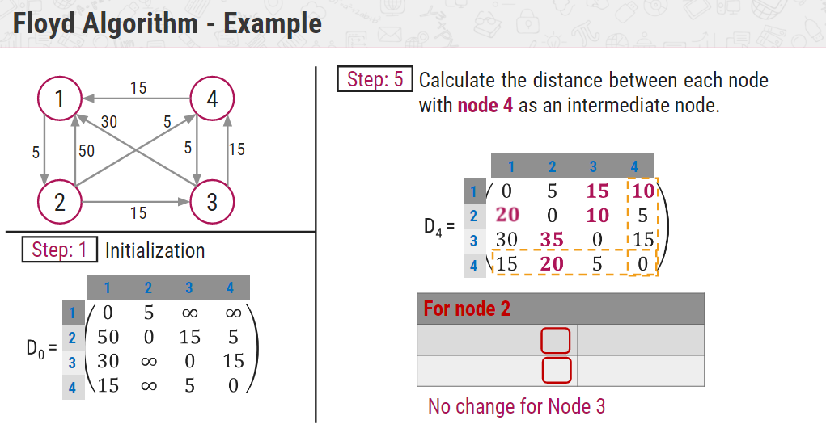
ALL PAIR SHORTEST PATH – FLOYD’S ALGORITHM

Slide 32
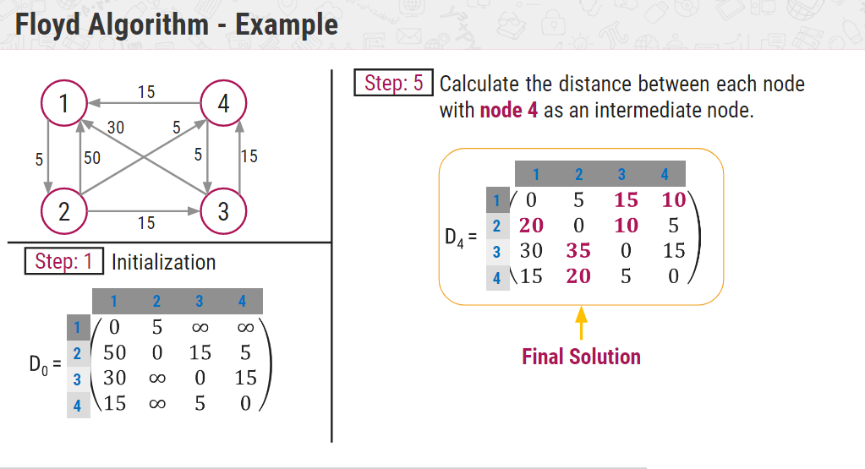
ALL PAIR SHORTEST PATH – FLOYD’S ALGORITHM

Slide 33
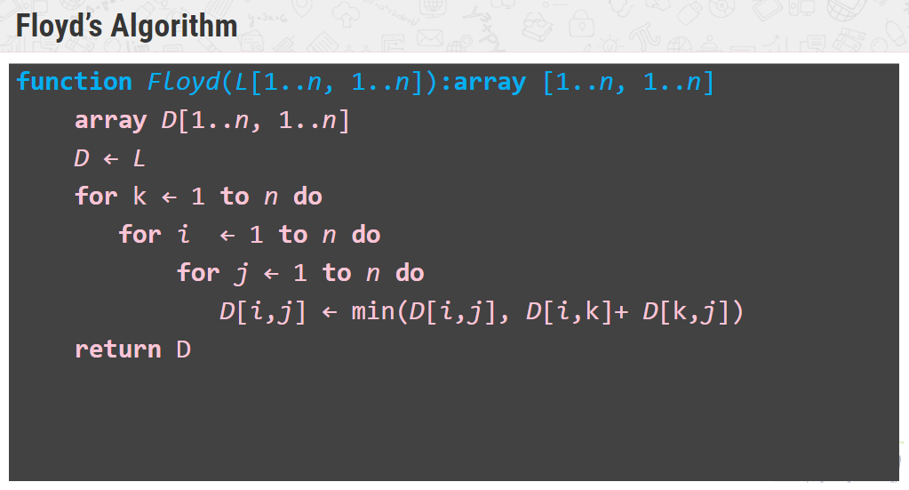
ALL PAIR SHORTEST PATH – FLOYD’S ALGORITHM

Slide 34
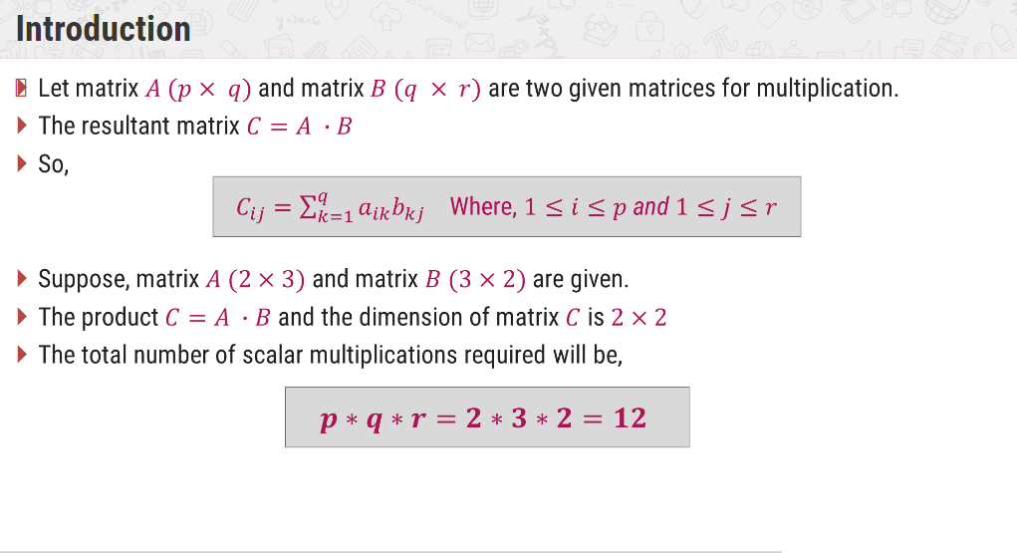
CHAIN MATRIX MULTIPLICATION

Slide 35
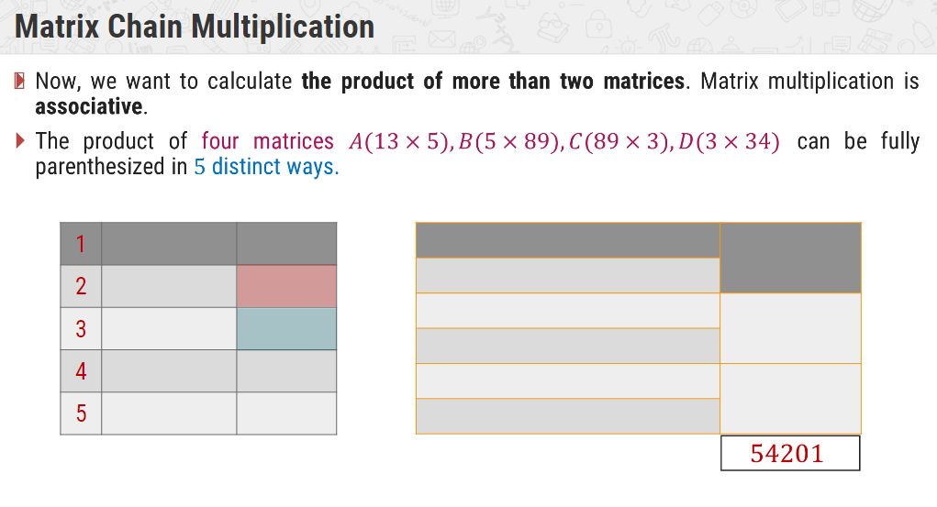
CHAIN MATRIX MULTIPLICATION

Slide 36
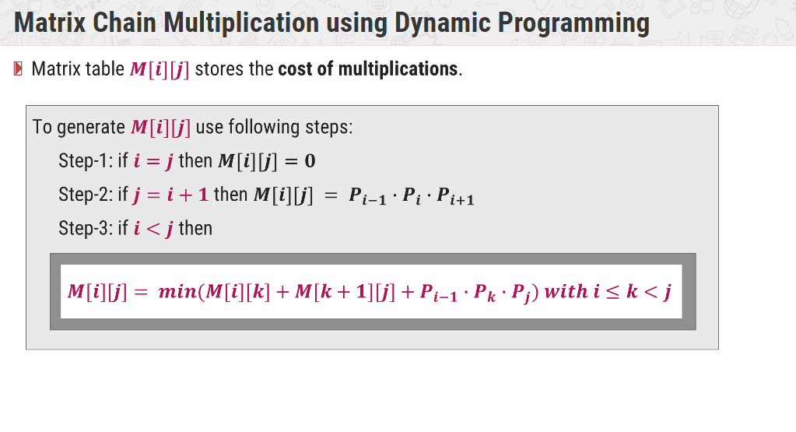
CHAIN MATRIX MULTIPLICATION

Slide 37
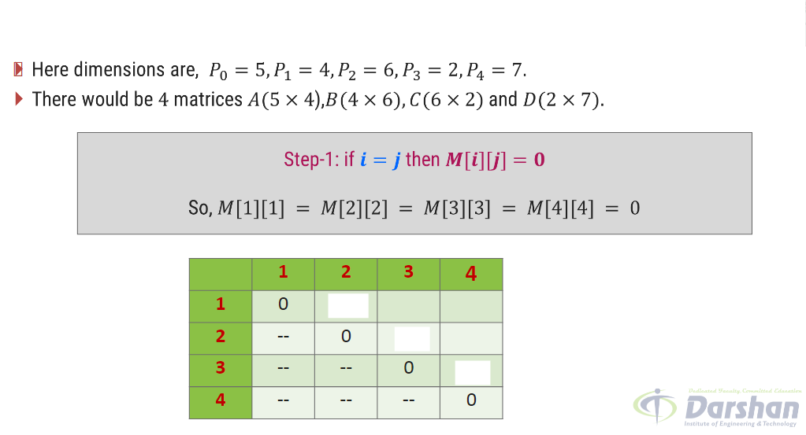
CHAIN MATRIX MULTIPLICATION

Slide 38
CHAIN MATRIX MULTIPLICATION

Slide 39
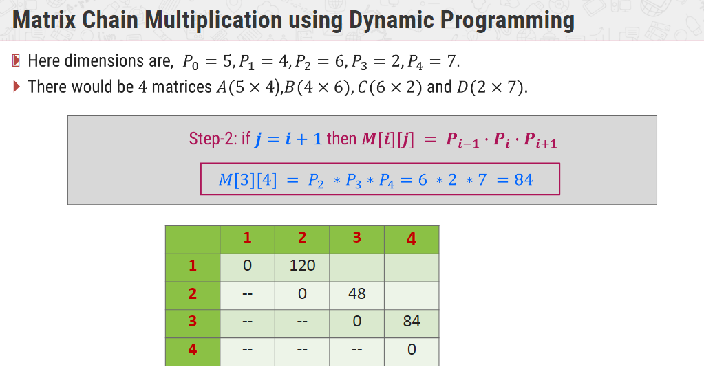
CHAIN MATRIX MULTIPLICATION

Slide 40
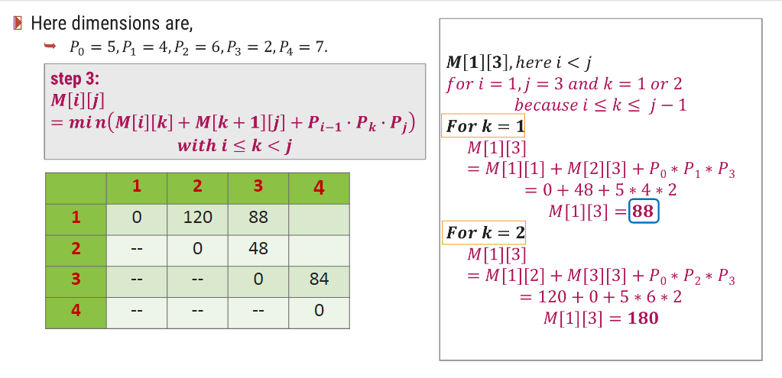
CHAIN MATRIX MULTIPLICATION

Slide 41
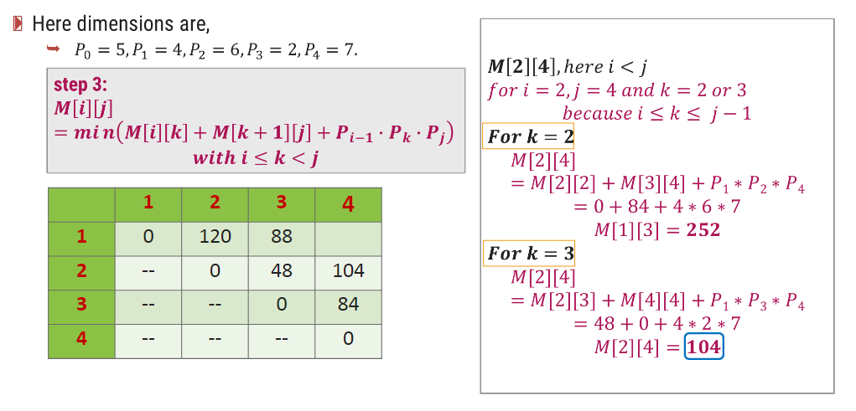
CHAIN MATRIX MULTIPLICATION

Slide 42
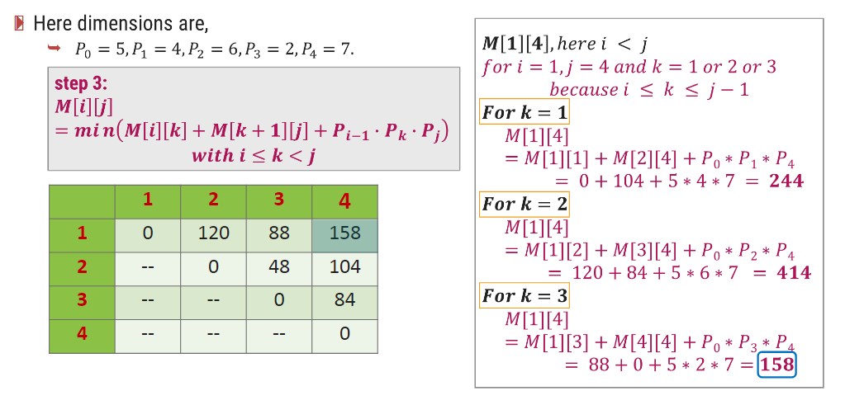
CHAIN MATRIX MULTIPLICATION

Slide 43
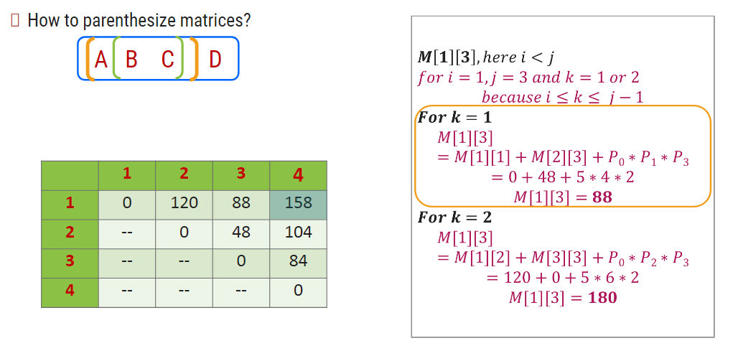
CHAIN MATRIX MULTIPLICATION

Slide 44
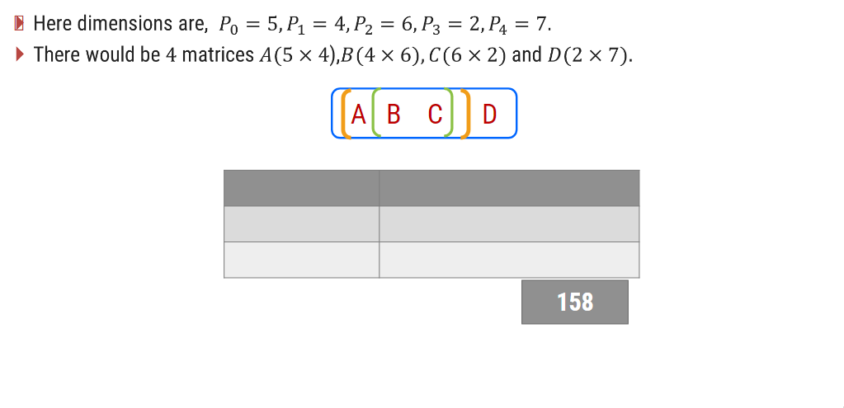
CHAIN MATRIX MULTIPLICATION

Slide 45
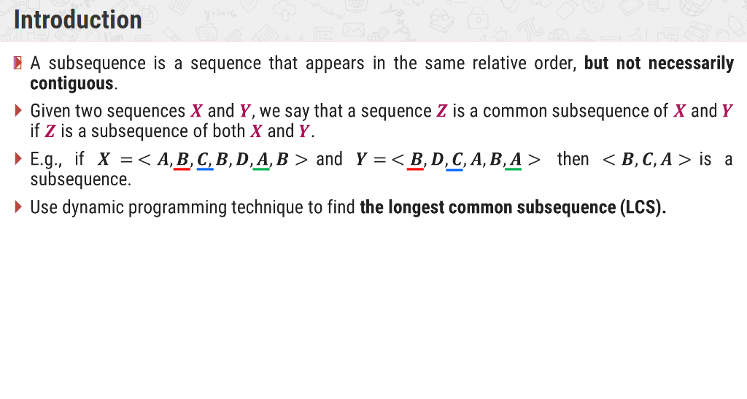
LONGEST COMMON SUBSEQUENCE

Slide 46
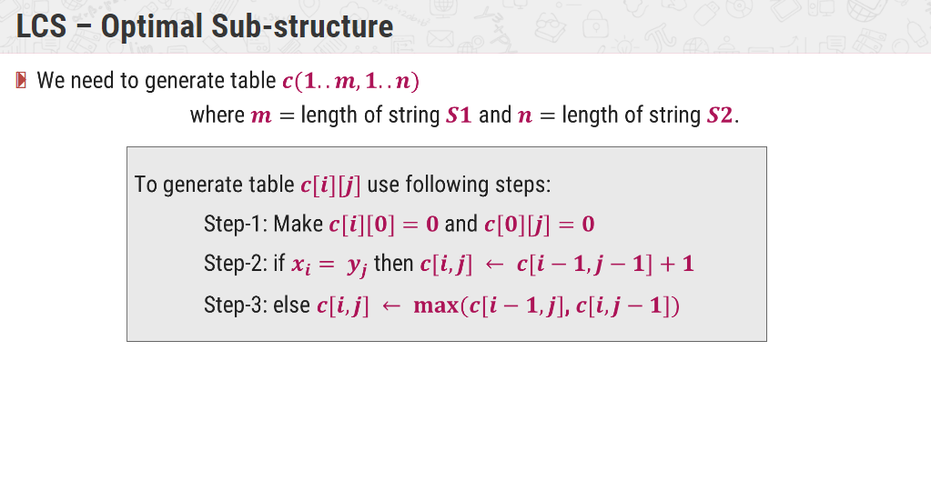
LONGEST COMMON SUBSEQUENCE

Slide 47
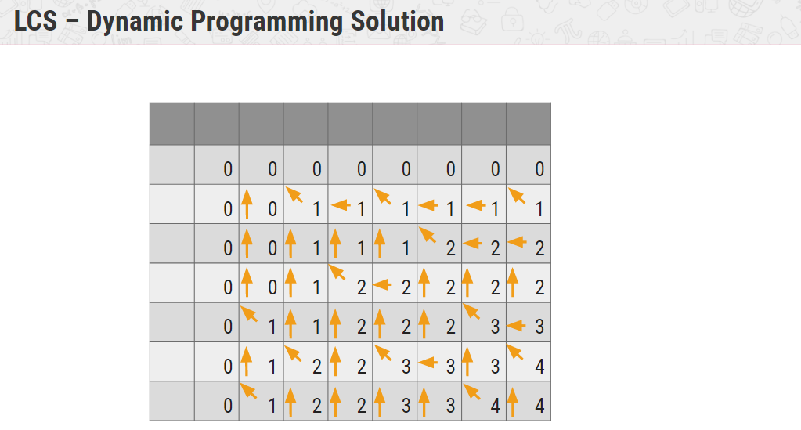
LONGEST COMMON SUBSEQUENCE

Slide 48
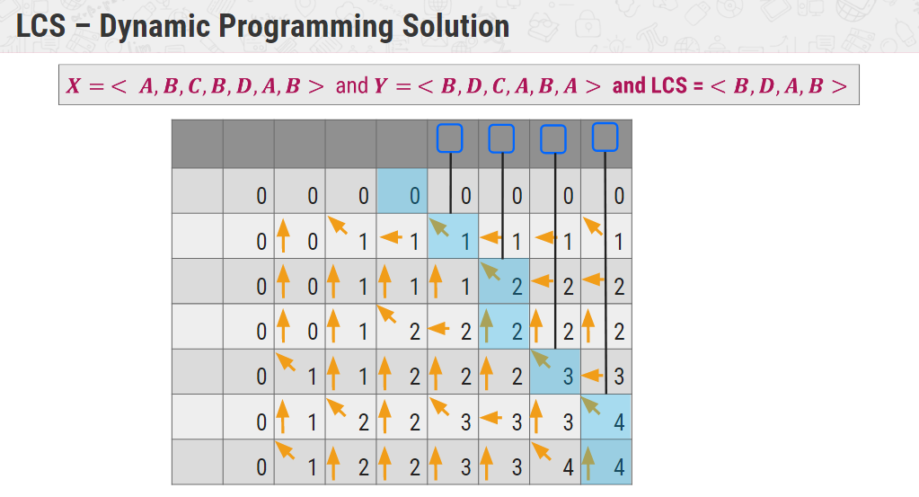
LONGEST COMMON SUBSEQUENCE

Slide 49
Greedy Algorithms
Optimization problems
  Dynamic programming, but overkill sometime.
  Greedy algorithm:
    Being greedy for local optimization with the hope it will lead to a global optimal solution, not always, but in many situations, it works.

Slide 50
An Activity-Selection Problem
Suppose A set of activities S={a₁, a₂,…, a_{n}}
  They use resources, such as lecture hall, one lecture at a time
  Each a_{i}, has a start time s_{i}, and finish time f_{i}, with 0≤ s_{i}< f_{i}<∝.
  a_{i} and a_{j} are compatible if [s_{i}, f_{i}) and [s_{j}, f_{j}) do not overlap
Goal: select maximum-size subset of mutually compatible activities.
Start from dynamic programming, then greedy algorithm, see the relation between the two.

Slide 51
DP solution –step 1
Optimal substructure of activity-selection problem.
  Furthermore, assume that f₁ ≤… ≤f_{n}.
  Define S_{ij}={a_{k}: f_{i}≤ s_{k}<f_{k}≤s_{j}}, i.e., all activities starting after a_{i} finished and ending before a_{j} begins.
  Define two fictitious activities a₀ with f₀=0 and a_{n+1} with s_{n+1}=∞
    So f₀ ≤f₁ ≤… ≤f_{n+1}.
  Then an optimal solution including a_{k} to S_{ij} contains within it the optimal solution to S_{ik} and S_{kj}.

Slide 52
DP solution –step 2
A recursive solution
Assume c[n+1,n+1] with c[i,j] is the number of activities in a maximum-size subset of mutually compatible activities in S_{ij}. So the solution is c[0,n+1]=S_{0,n+1}.
C[i,j]= 0 if S_{ij}=∅ max{c[i,k]+c[k,j]+1} if S_{ij}≠∅
      i<k<j and a_{k}∈S_{ij}
How to implement?
  How to compute the initial cases by checking S_{ij}=∅?
  How to loop to iteratively compute C[i,j]:
  For i=… for j=… for k=…? This is wrong?
  Need to be similar to MCM:
    For len=… for i=… j=i+len; for k=…

Slide 53
Converting DP Solution to Greedy Solution
Theorem 16.1: consider any nonempty subproblem S_{ij}, and let a_{m} be the activity in S_{ij} with earliest finish time: f_{m}=min{f_{k} : a_{k} ∈ S_{ij}}, then
Activity a_{m} is used in some maximum-size subset of mutually compatible activities of S_{ij}.
The subproblem S_{im} is empty, so that choosing a_{m} leaves S_{mj} as the only one that may be nonempty.
Proof of the theorem:

Slide 54
Top-Down Rather Than Bottom-Up
To solve S_{ij}, choose a_{m} in S_{ij} with the earliest finish time, then solve S_{mj}, (S_{im} is empty)
It is certain that optimal solution to S_{mj} is in optimal solution to S_{ij}.
No need to solve S_{mj} ahead of S_{ij}.
Subproblem pattern: S_{i,n+1}.

Slide 55
Optimal Solution Properties
In DP, optimal solution depends:
  How many subproblems to divide. (2 subproblems)
  How many choices to determine which subproblem to use. (j-i-1 choices)
However, the above theorem (16.1) reduces both significantly
  One subproblem (the other is sure to be empty).
  One choice, i.e., the one with earliest finish time in S_{ij}.
  Moreover, top-down solving, rather than bottom-up in DP.
  Pattern to the subproblems that we solve, S_{m,n+1} from S_{ij}.
  Pattern to the activities that we choose. The activity with earliest finish time.
  With this local optimal, it is in fact the global optimal.

Slide 56
Elements of greedy strategy
Determine the optimal substructure
Develop the recursive solution
Prove one of the optimal choices is the greedy choice yet safe
Show that all but one of subproblems are empty after greedy choice
Develop a recursive algorithm that implements the greedy strategy
Convert the recursive algorithm to an iterative one.

Slide 57
Greedy vs. DP
Knapsack problem
  I1 (v1,w1), I2(v2,w2),…,In(vn,wn).
  Given a weight W at most he can carry,
  Find the items which maximize the values
Fractional knapsack,
  Greed algorithm, O(nlogn)
0/1 knapsack.
  DP, O(nW).
  Questions: 0/1 knapsack is an NP-complete problem, why O(nW) algorithm?

Slide 58
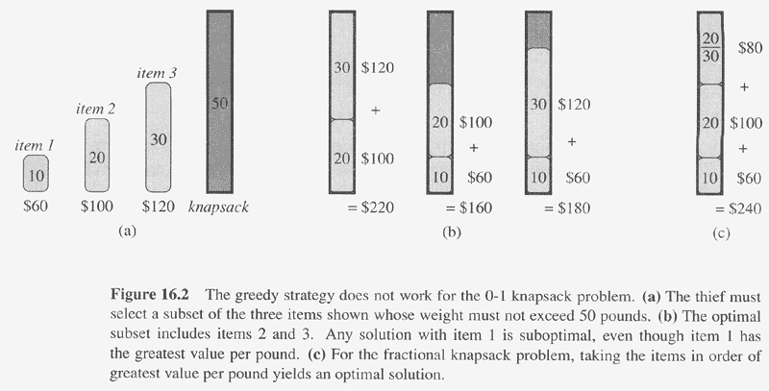

Slide 59
Maximum attendance
A little bit change to the previous activity selection. For each activity a_{i} such as a talk, there is an associated attendance att_{i}.
  i.e., given {a₁,a₂,…,a_{n}}={(s₁,f₁,att₁),(s₂,f₂,att₂),…(s_{n},f_{n},att_{n}), compute its maximum attendance of compatible activities.
Use the one similar to the previous activity-selection:
C[i,j]= 0 if S_{ij}=∅ max{c[i,k]+c[k,j]+att_{k}} if S_{ij}≠∅
      i<k<j and a_{k}∈S_{ij}

Slide 60
Maximum attendance (cont.)
New analysis (easy to think sort activities):
  For any a_{i}, which is the most recent previous one compatible with it?
    so, define P(i)=max{k: k<i && f_{k}≤ s_{i}}.
    compute P(i) is easy. P(1)=0. (for easy coding, a dummy a₀=(0,0,0))
  Also, define T(i): the maximum attendance of all compatible activities from a₁ to a_{i}. T(n) will be an answer.
  Consider activity a_{i}, two cases:
    a_{i} is contained within the solution, then only a_{P(i)} can be included too.
    a_{i} is not included, then a_{i-1} can be included.
  T(i)= 0 if i=0
      max{T(i-1),att_{i}+T(P(i))} if i>0

Slide 61
Typical tradition problem with greedy solutions
Coin changes
  25, 10, 5, 1
  How about 7, 5, 1
Minimum Spanning Tree
  Prim’s algorithm
    Begin from any node, each time add a new node which is closest to the existing subtree.
  Kruskal’s algorithm
    Sorting the edges by their weights
    Each time, add the next edge which will not create cycle after added.
Single source shortest pathes
  Dijkstra’s algorithm
Huffman coding
Optimal merge

Slide 62
THANK YOU

